Slide 1

CSI300 Investment Strategy & Portfolio Risk Control base on Health Rate
Junming Zhang

Slide 2
What’s the background?
What’s the dataset?
What’s the model and performance?

Slide 3
Background
Goal: Maximize the total gain based on CSI300 data by factor investment
Factor investment: maximize gain with factors, such as standard deviation, high/low/open/close price
Method: train a model to suggest investment (output a health rate and make decision based on some interval for this health rate)
Some upper bound: U
Some lower bound: L
Health rate < L: short position
L < health rate < U: half position
Health rate > U: full position
CSI300 can be derived by Qlib library functions

Slide 4
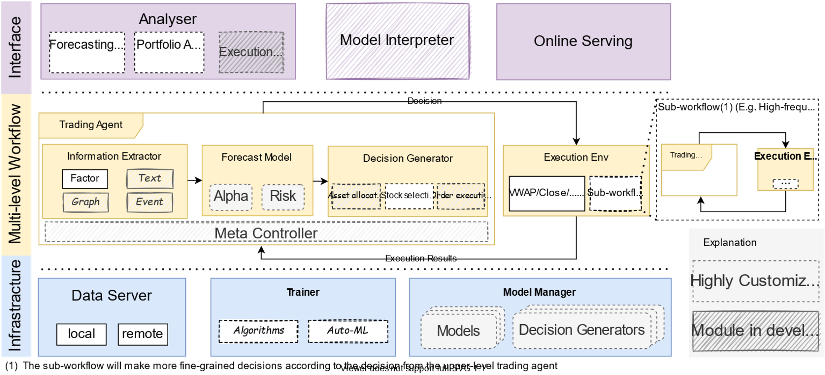
Qlib
AI-oriented quantitative investment platform
contains ML pipeline of data processing, model training, back-testing
covers chain of quantitative investment, like alpha seeking, risk modeling, portfolio optimization, and order execution

Slide 5
Usage of Qlib
Obtain data (CSI300 stocks)
Compare models in Qlib (LightGBM, LSTM)

Slide 6
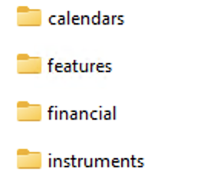
Dataset
Derived by Qlib tools
python scripts/get_data.py qlib_data --target_dir ~/.qlib/qlib_data/cn_data --region cn
After downloading data, I selected 5 stocks randomly, and then selected SH000300 as benchmark
SH600372, SZ002142, SH600705, SH600030, SH600100

Slide 7
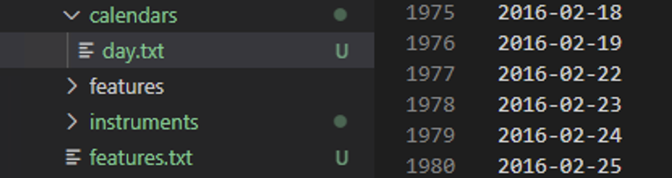
Calendars
All dates covered by the dataset
From 2008/01/02 ~ 2020/07/31

Slide 8
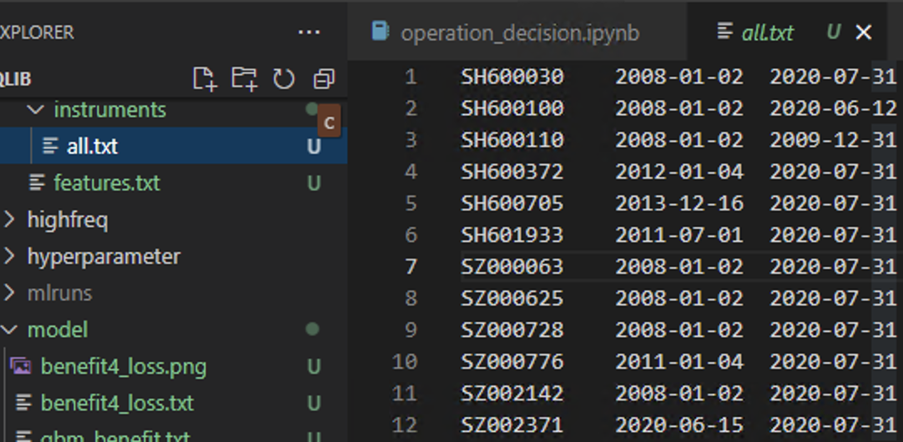
Instruments
Include each stock and the start and end date for each stock

Slide 9
Features
Alpha158
Alpha360
Self-calculated
Targets

Slide 10
Features (factors)
Alpha360
Open(59 ~ 1): "Ref($open, %d)/$close" % (i)
Open0: "$open/$close”
Close(59 ~ 1): "Ref($close, %d)/$close" % (i)
Close0: "$close/$close"
High(59 ~ 1): "Ref($high, %d)/$close" % (i)
High0: "$high/$close”
Low(59 ~ 1): "Ref($low, %d)/$close" % (i)
Low0: "$low/$close”
Vwap(59 ~ 1): "Ref($vwap, %d)/$close" % (i)
Vwap0: "$vwap/$close”
Volumn(59 ~ 1): "Ref($volume, %d)/($volume+1e-12)" % (i)
"$volume/($volume+1e-12)"

Slide 11
Features (factors)
Alpha158
KMID: ($close-$open)/$open
KLEN: ($high-$low)/$open
KMID2: ($close-$open)/($high-$low+1e-12)
KUP: ($high-Greater($open, $close))/$open
KUP2: ($high-Greater($open, $close))/($high-$low+1e-12)
KLOW: (Less($open, $close)-$low)/$open
KLOW2: (Less($open, $close)-$low)/($high-$low+1e-12)
KSFT: (2*$close-$high-$low)/$open
KSFT2: (2*$close-$high-$low)/($high-$low+1e-12)

Slide 12
Features (factors)
Alpha360:
ROC: "Ref($close, %d)/$close" % d
MA: "Mean($close, %d)/$close" % d
STD: "Std($close, %d)/$close" % d
BETA: "BETA%d" % d
RSQR: "Rsquare($close, %d)" % d
RESI: "Resi($close, %d)/$close" % d
MAX: "Max($high, %d)/$close" % d
LOW: "Min($low, %d)/$close" % d
QTLU: "Quantile($close, %d, 0.8)/$close" % d
QTLD: "Quantile($close, %d, 0.2)/$close" % d
RANK: "Rank($close, %d)" % d
RSV: "($close-Min($low, %d))/(Max($high, %d)-Min($low, %d)+1e-12)" % (d, d, d)
IMAX: "IdxMax($high, %d)/%d" % (d, d)
IMIN: "IdxMin($low, %d)/%d" % (d, d)
IMXD: "(IdxMax($high, %d)-IdxMin($low, %d))/%d" % (d, d, d)
CORR: Corr($close, Log($volume+1), %d)" % d
CORD: "Corr($close/Ref($close,1), Log($volume/Ref($volume, 1)+1), %d)" % d

Slide 13
Features (factors)
Alpha360:
CNTP: "Mean($close>Ref($close, 1), %d)" % d
CNTN: "Mean($close<Ref($close, 1), %d)" % d for d
CNTD: "Mean($close>Ref($close, 1), %d)-Mean($close<Ref($close, 1), %d)" % (d, d)
SUMP: "Sum(Greater($close-Ref($close, 1), 0), %d)/(Sum(Abs($close-Ref($close, 1)), %d)+1e-12)" % (d, d)
SUMN: "Sum(Greater(Ref($close, 1)-$close, 0), %d)/(Sum(Abs($close-Ref($close, 1)), %d)+1e-12)" % (d, d)
SUMD: "(Sum(Greater($close-Ref($close, 1), 0), %d)-Sum(Greater(Ref($close, 1)-$close, 0), %d)) /(Sum(Abs($close-Ref($close, 1)), %d)+1e-12)” % (d, d, d)
VMA: "Mean($volume, %d)/($volume+1e-12)" % d
VSTD: "Std($volume, %d)/($volume+1e-12)" % d
WVMA: "Std(Abs($close/Ref($close, 1)-1)*$volume, %d)/(Mean(Abs($close/Ref($close, 1)-1)*$volume, %d)+1e-12)” % (d, d)
VSUMP: "Sum(Greater($volume-Ref($volume, 1), 0), %d)/(Sum(Abs($volume-Ref($volume, 1)), %d)+1e-12)” % (d, d)
VSUMN: "Sum(Greater(Ref($volume, 1)-$volume, 0), %d)/(Sum(Abs($volume-Ref($volume, 1)), %d)+1e-12)” % (d, d)
VSUMD: "(Sum(Greater($volume-Ref($volume, 1), 0), %d)-Sum(Greater(Ref($volume, 1)-$volume, 0), %d)) /(Sum(Abs($volume-Ref($volume, 1)), %d)+1e-12)” % (d, d, d)

Slide 14
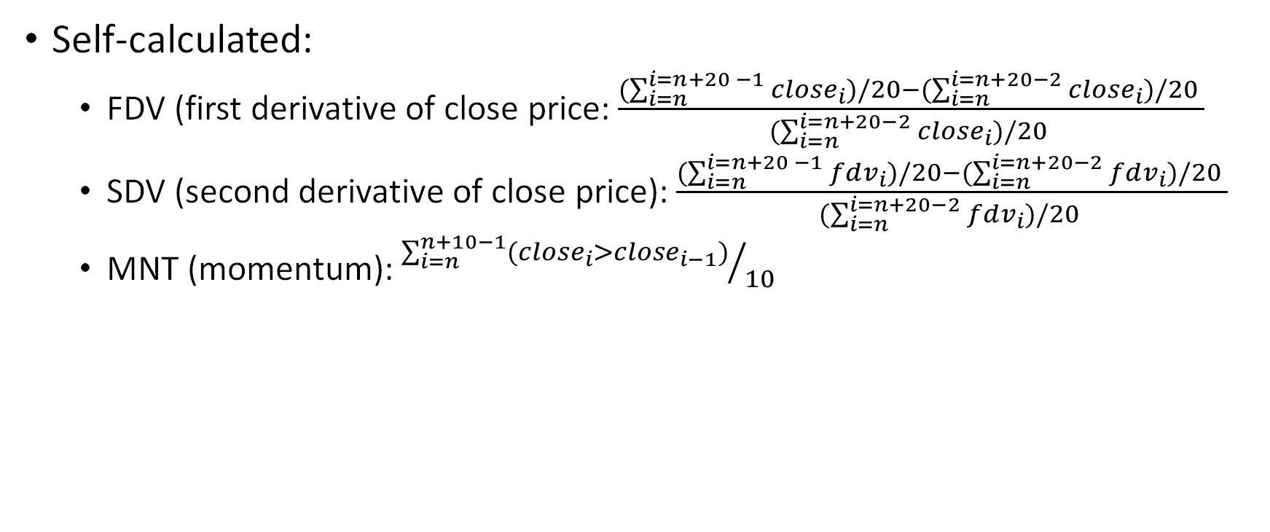
Features (factors)
Self-calculated:
FDV (first derivative of close price: $\frac{(\sum_{i=n}^{i=n+20 −1}{close_{i})/20}−(\sum_{i=n}^{i=n+20−2}{close_{i})/20 }}{(\sum_{i=n}^{i=n+20−2}{close_{i})/20 }}$
SDV (second derivative of close price): $\frac{(\sum_{i=n}^{i=n+20 −1}{fdv_{i})/20}−(\sum_{i=n}^{i=n+20−2}{fdv_{i})/20 }}{(\sum_{i=n}^{i=n+20−2}{fdv_{i})/20 }}$
MNT (momentum): ${\sum_{i=n}^{n+10−1}{(close_{i}>close_{i−1})}}/{10}$

Slide 15
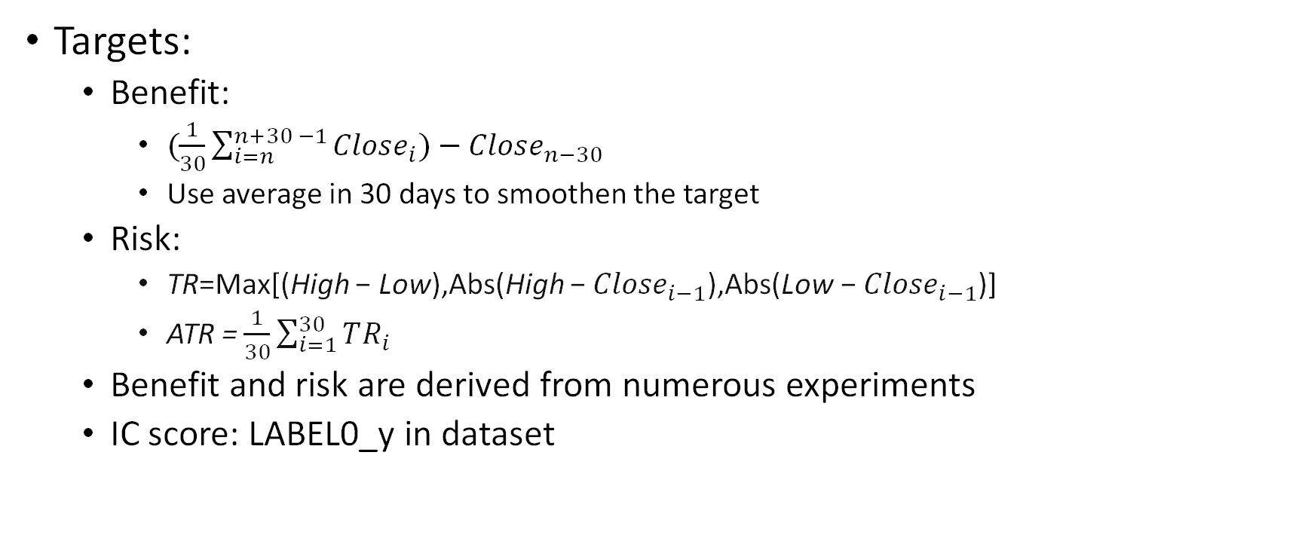
Features
Targets:
Benefit:
$(\frac{1}{30}\sum_{i=n}^{n+30 −1}{Close_{i})}−Close_{n−30}$
Use average in 30 days to smoothen the target
Risk:
TR=Max[(High − Low),Abs(High − ${Close}_{i−1}$​),Abs(Low − ${Close}_{i−1}$​)]
ATR = $\frac{1}{30}\sum_{i=1}^{30}{TR_{i}}$
Benefit and risk are derived from numerous experiments
IC score: LABEL0_y in dataset

Slide 16
Health rate
Use health rate to suggest on investment (mentioned in background)
How to get health rate?
Two ways:
Health rate1: benefit / risk
Health rate2: IC score (provided in dataset, LABEL0_y)

Slide 17
Model
Compared LightGBM and LSTM, two models provided by Qlib library
Finally selected LSTM, because its structure is easy to update
Use 30-day data to predict the target in 31st day (a time-series data)
LSTM model is good at working with time series data
Self-implemented data loader to achieve this
What to predict?
Health rate1:
train two LSTM models, one predict benefit, another predict risk
Benefit / risk to derive health rate
Health rate2:
Train one LSTM to predict the health rate directly, because the y label is provided in the dataset

Slide 18

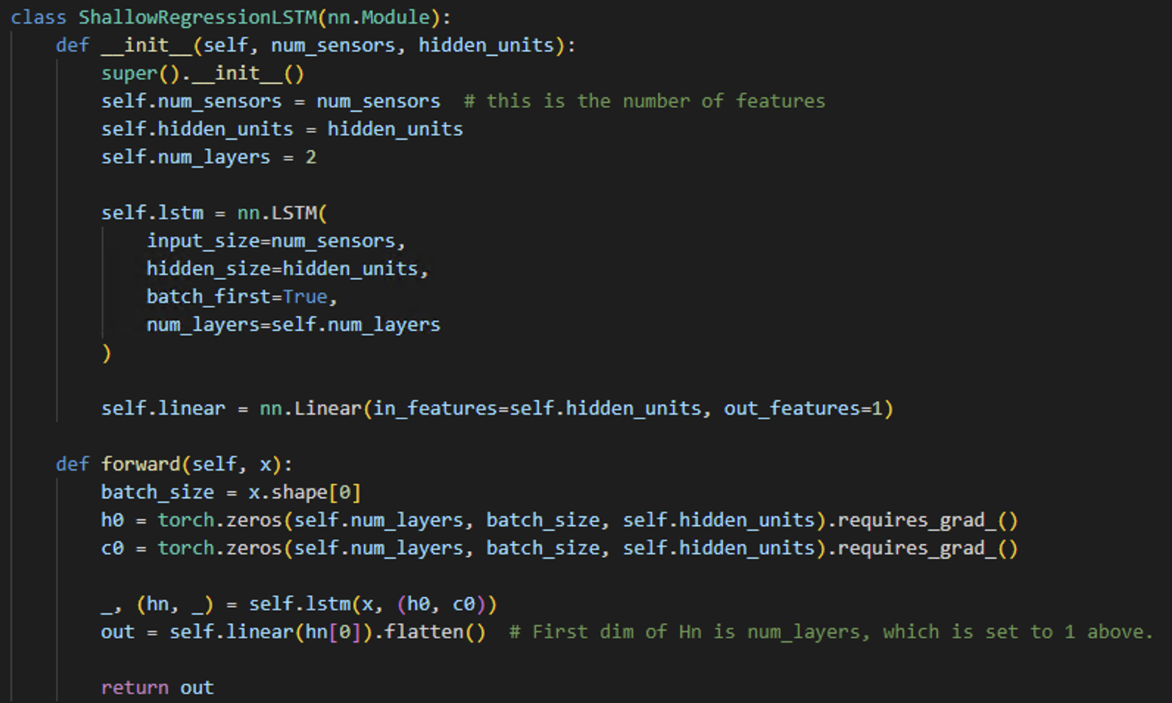
Model

Slide 19
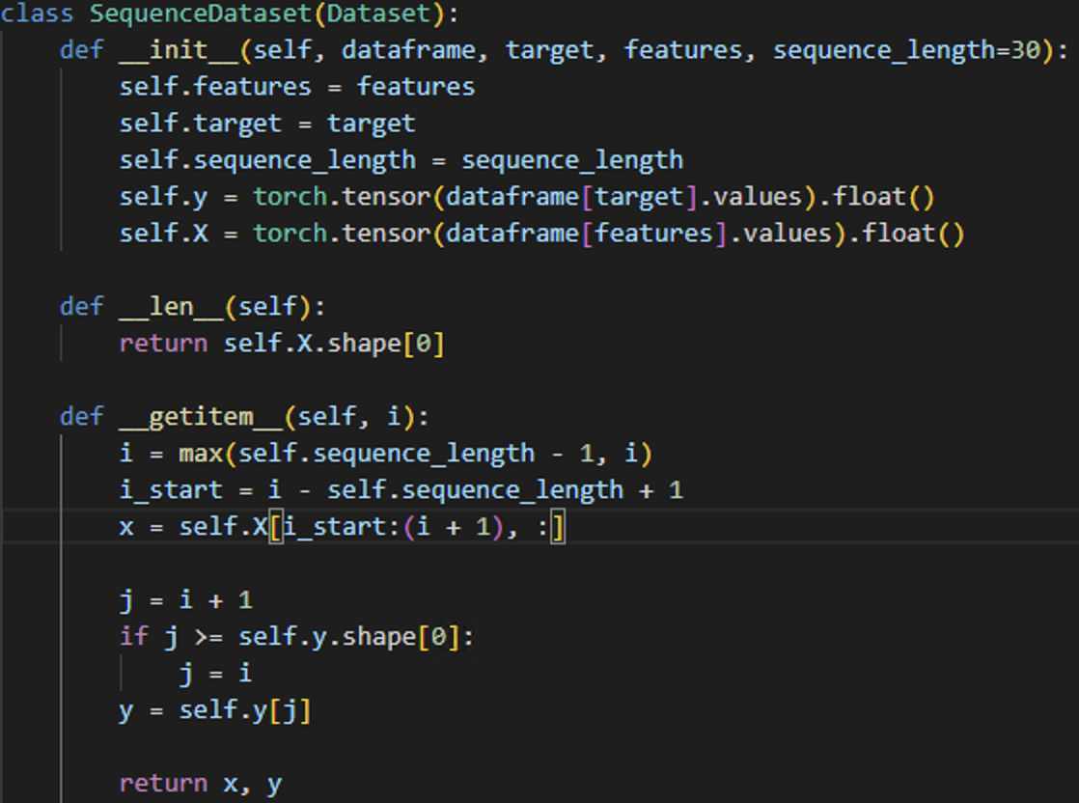
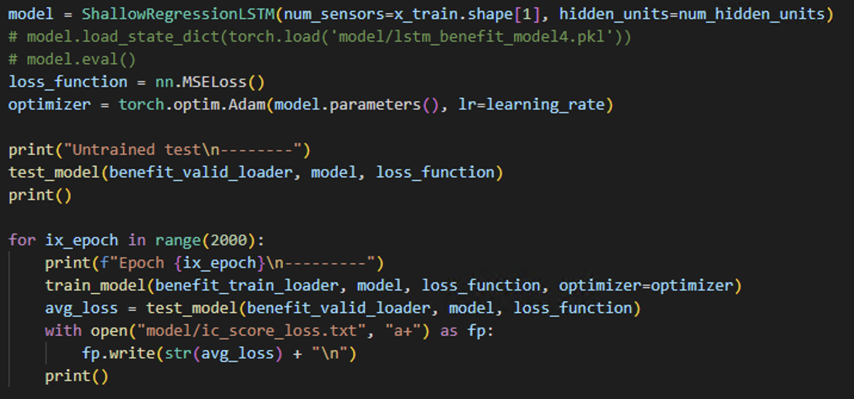
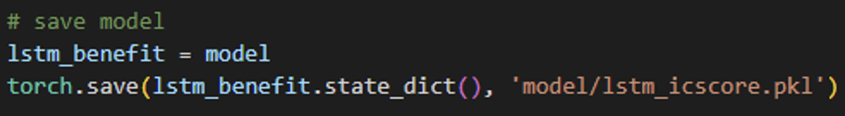
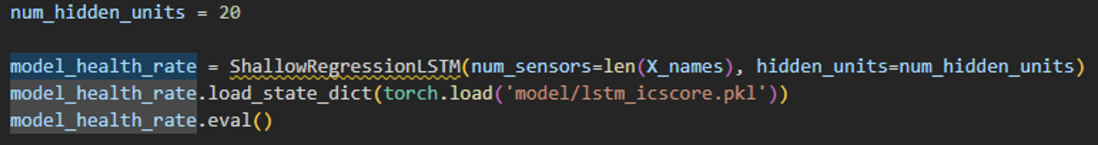
Model implementation
Data loader: take CSV data
Initialize model with parameters
Train model
Save model
Load model to make prediction

Slide 20
Model parameters
Sequence_length (default 30): number of data rows take to train and predict
hidden_units: 20
num_layers: 2
batch_size: 5
Learning rate: 1e-5
Training with data from 2008/01/01 to 2016/12/30

Slide 21
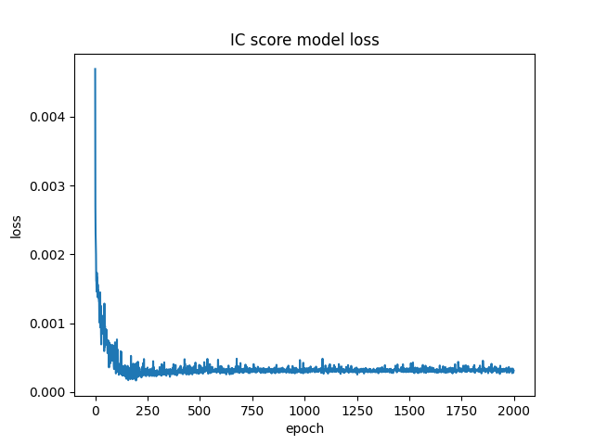
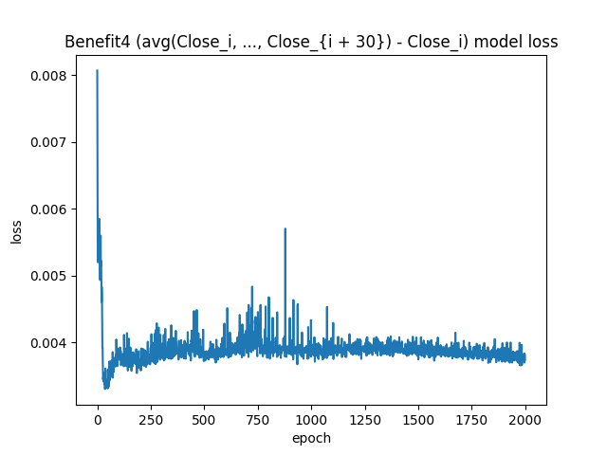
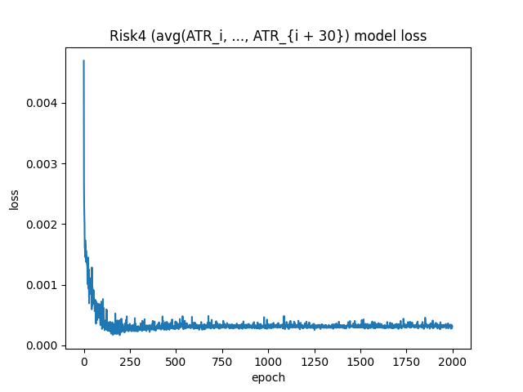
Model training process
IC score model training process
(health rate 1)
Benefit model training process
Risk model training process
health rate 2 = benefit / risk

Slide 22
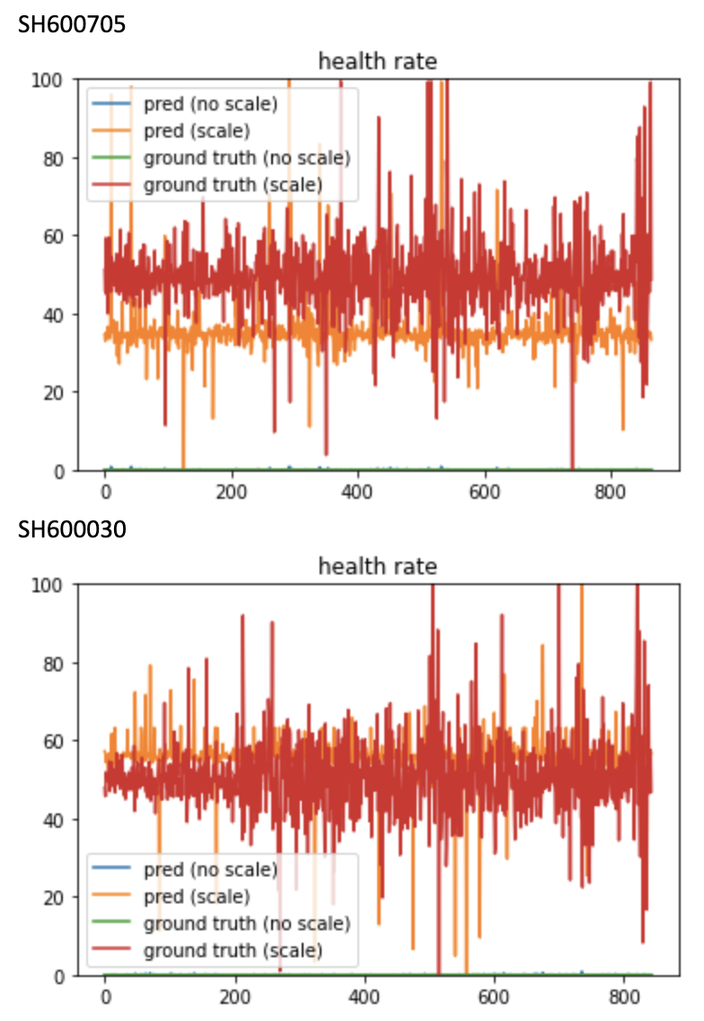
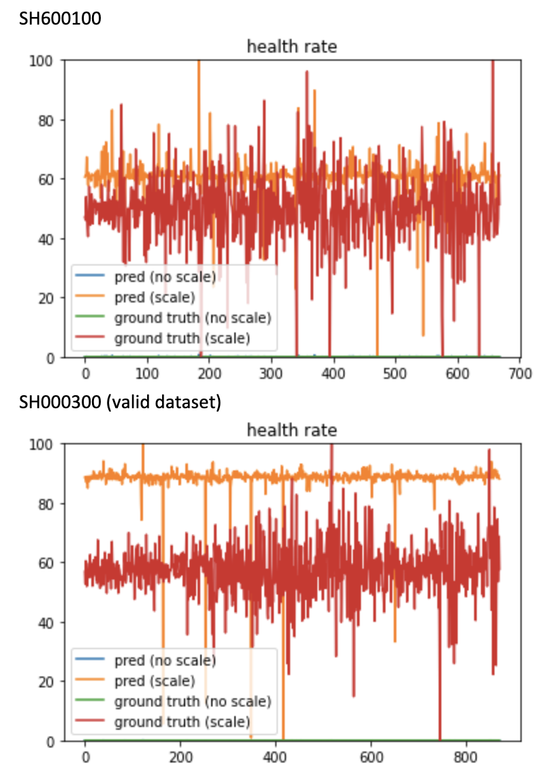
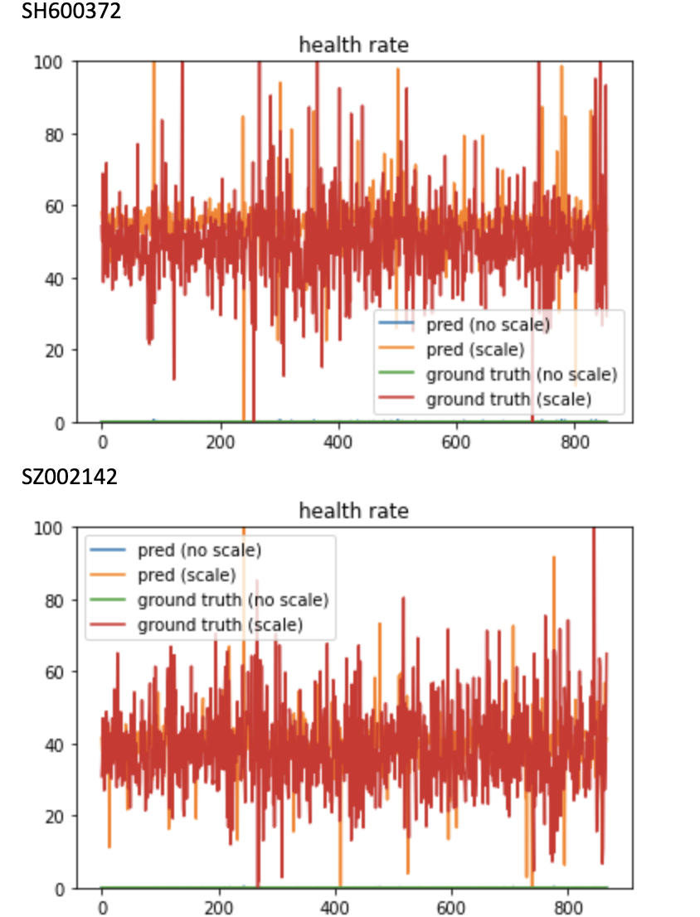
Performance (health rate 1)
Tested on benchmark (SH000300) and other stocks

Slide 23
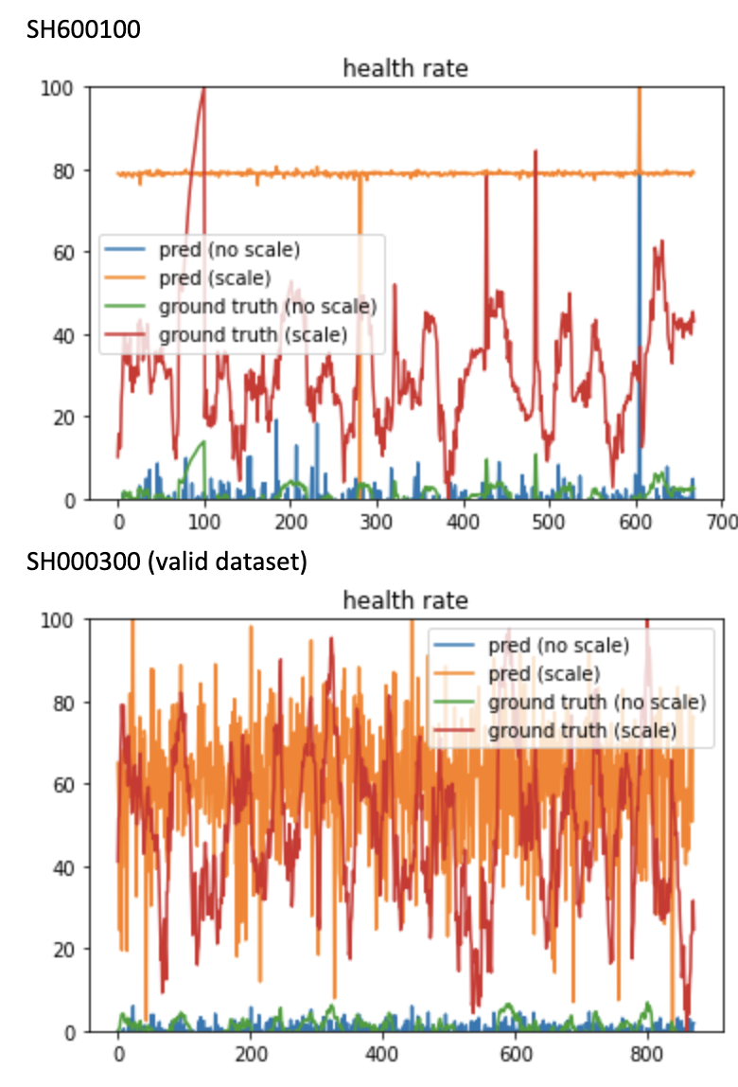
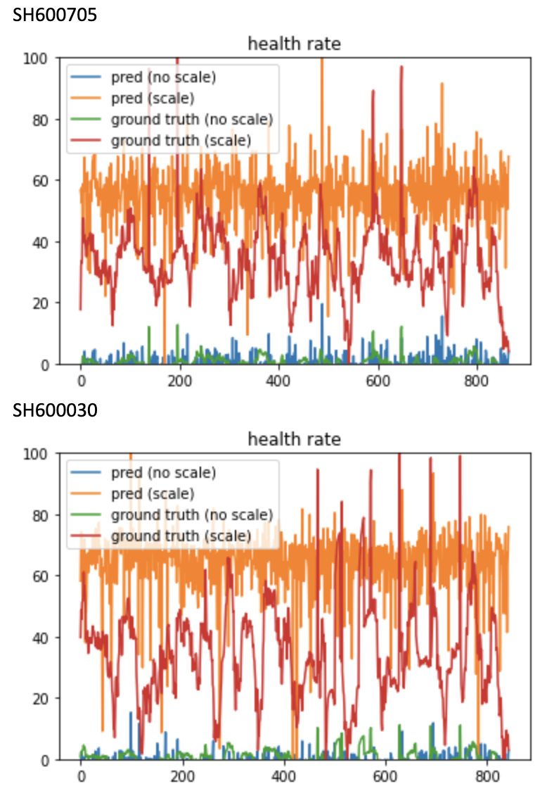
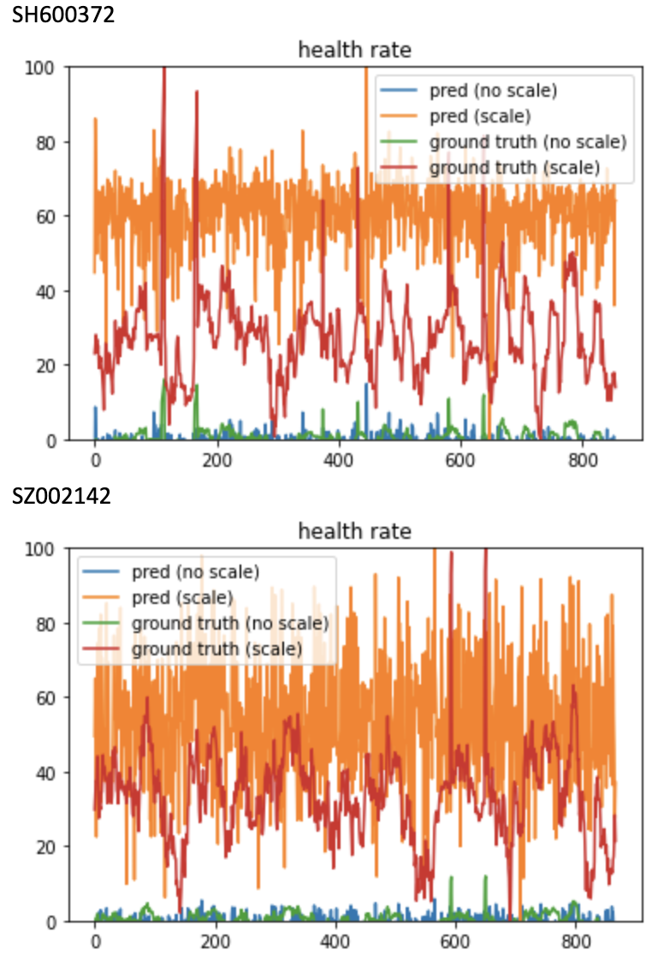
Performance (health rate 2)
Tested on benchmark (SH000300) and other stocks

Slide 24
Performance
Test with data from 2017/01/01 to 2020/08/31
Model for health rate 1 (IC score) makes predictions closer to the ground truth
Health rate2 (benefit / risk, where benefit and risk are given by two separate models) is far from the ground truth, and the ground truth vibrates in some rule at local scale, which is not reasonable

Slide 25
Scale
The model produced health rate is scaled to 0 ~ 100 for comparing with the upper and lower bound (introduced in background section)
Tool: sklearn.preprocessing.MinMaxScaler
Doc: https://scikit-learn.org/stable/modules/generated/sklearn.preprocessing.MinMaxScaler.html

Slide 26
Investment process
After getting the health rate, we start investment
Strategy:
Some upper bound: U
Some lower bound: L
Health rate < L: short position (sell all positions)
L < health rate < U: half position (keep half positions and half cash)
Health rate > U: full position (invest all cash)
Compute total gain rate:
Three situations: short position, half position, full position
Total gain today (full position) = (1 + total gain last day) * (1 + volatility today) -1
Total gain today (half position) = (1 + total gain last day) * position ratio * (1 + volatility today) + (1 + total gain last day) * cash ratio - 1
Total gain today (short position) = total gain last day
Investment steps:
Get predictions on health rate from model
For each prediction, make investment based on the strategy above
Compute the total gain (from the start date to the current date)

Slide 27
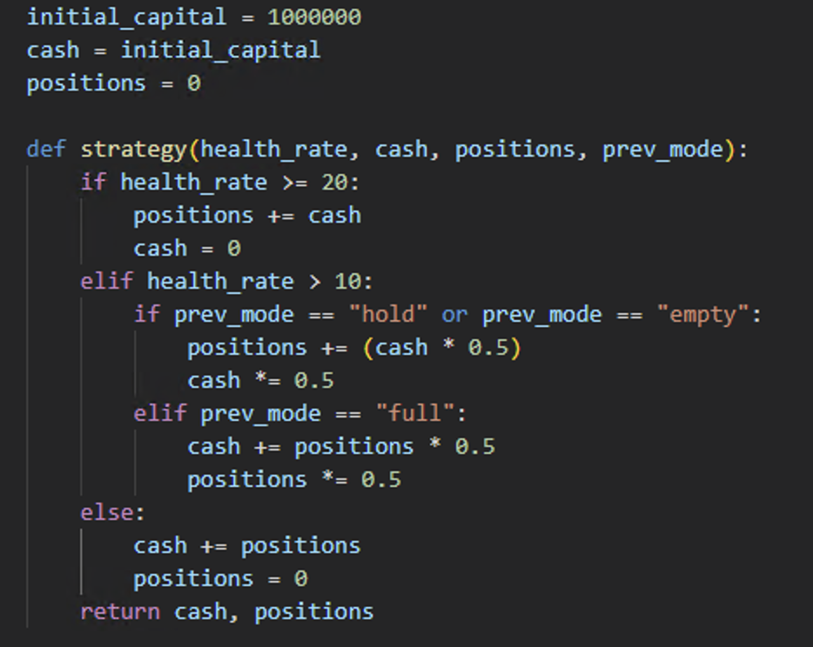
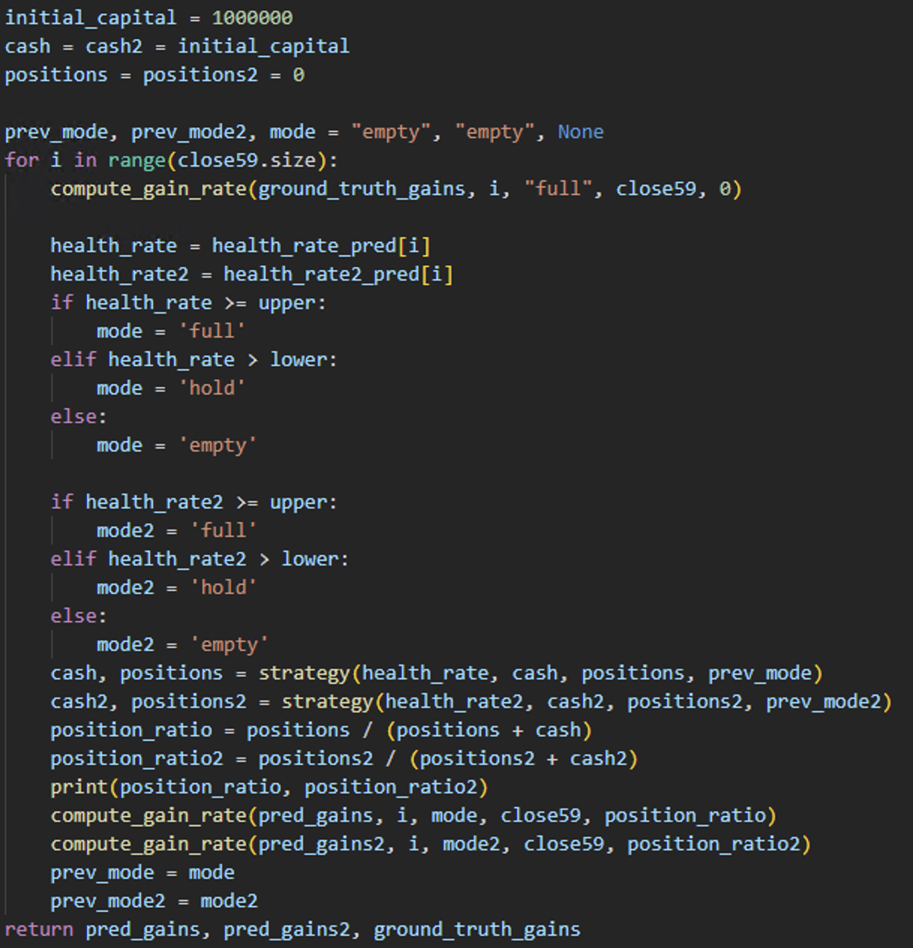
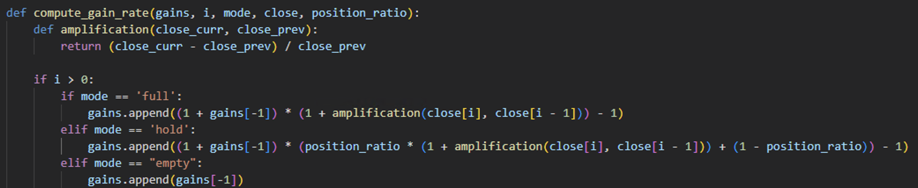
Investment process Implementation
Investment process

Slide 28
Total gain: ground truth vs model suggestion
Experiment many intervals on benchmark stock data (SH000300)

Slide 29
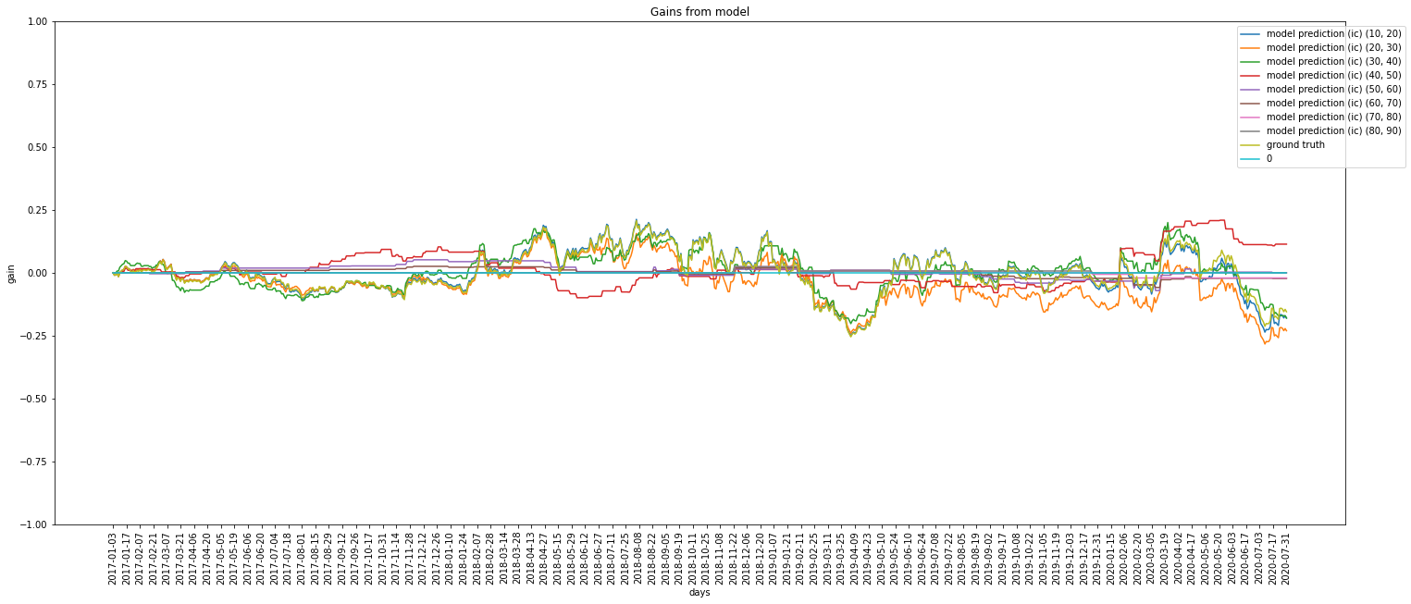
Total gain: ground truth vs model suggestion
Experiment on different upper/lower bounds
IC score (health rate 1)
Interval length: 10

Slide 30
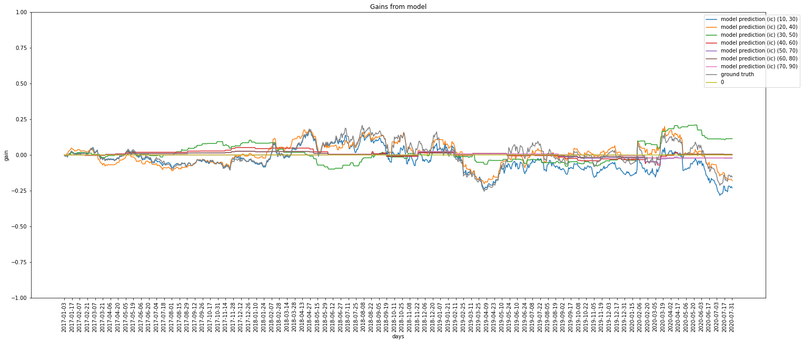
Total gain: ground truth vs model suggestion
Experiment on different upper/lower bounds
IC score (health rate 1)
Interval length: 20

Slide 31
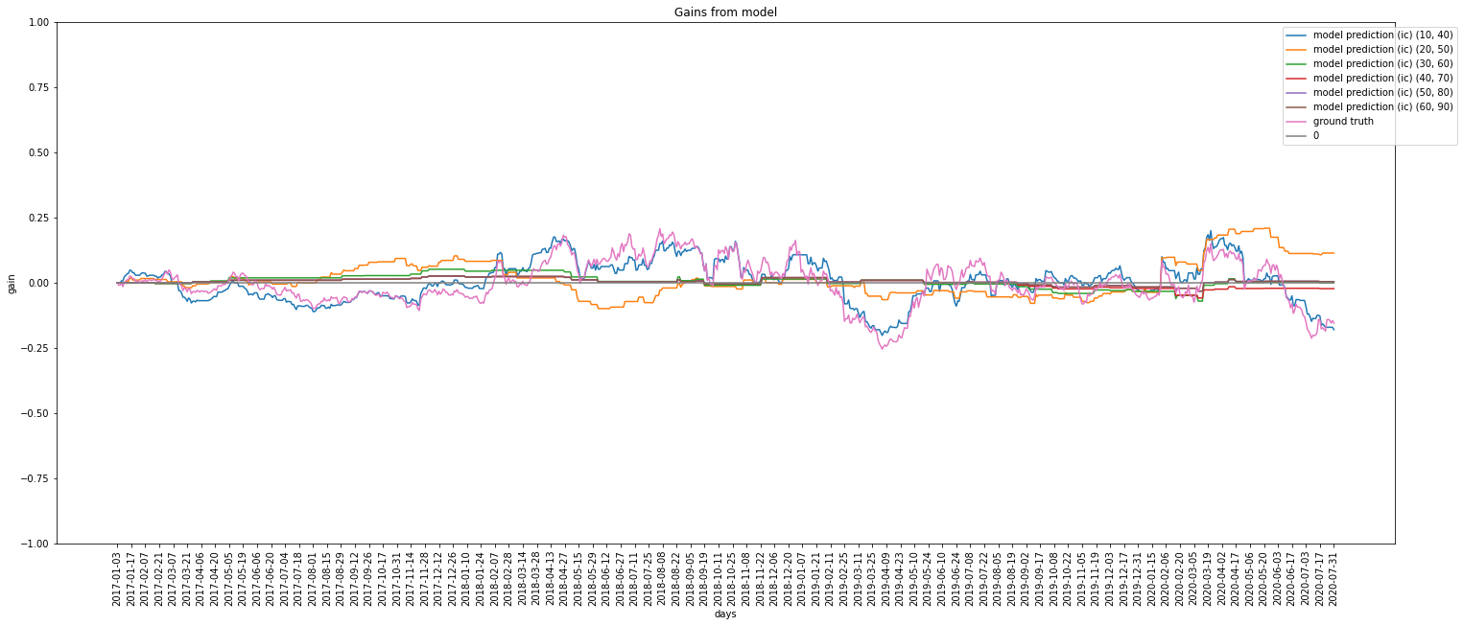
Total gain: ground truth vs model suggestion
Experiment on different upper/lower bounds
IC score (health rate 1)
Interval length: 30

Slide 32
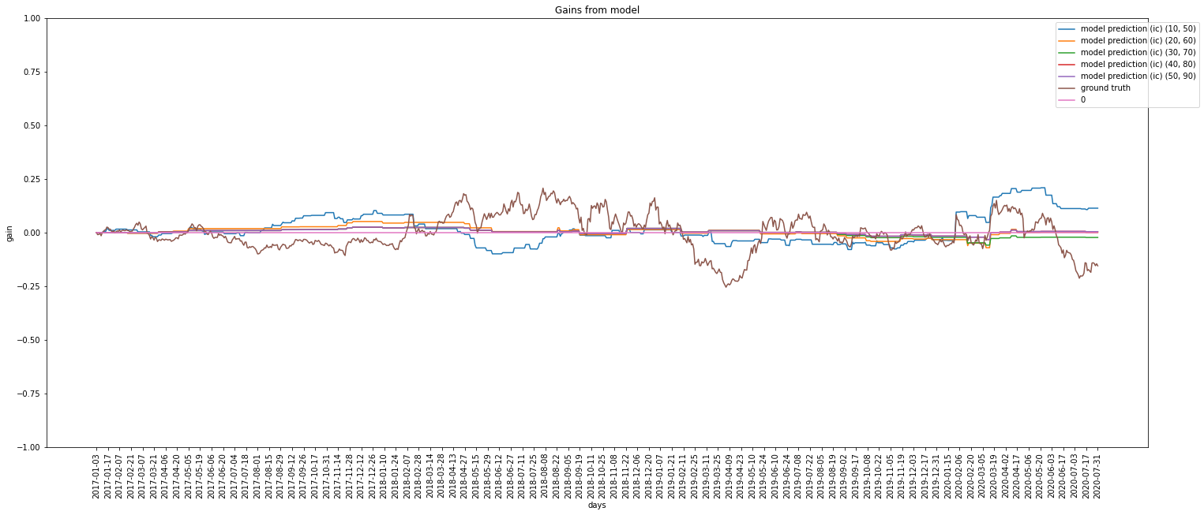
Total gain: ground truth vs model suggestion
Experiment on different upper/lower bounds
IC score (health rate 1)
Interval length: 40

Slide 33
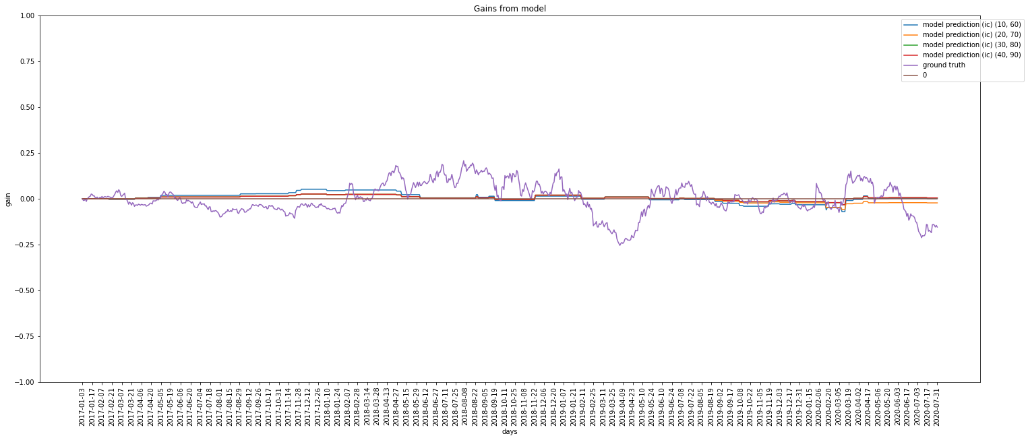
Total gain: ground truth vs model suggestion
Experiment on different upper/lower bounds
IC score (health rate 1)
Interval length: 50

Slide 34
Total gain: ground truth vs model suggestion
Experiment on different upper/lower bounds
Benefit / risk (health rate 2)
Interval length: 10

Slide 35
Total gain: ground truth vs model suggestion
Experiment on different upper/lower bounds
Benefit / risk (health rate 2)
Interval length: 20

Slide 36
Total gain: ground truth vs model suggestion
Experiment on different upper/lower bounds
Benefit / risk (health rate 2)
Interval length: 30

Slide 37
Total gain: ground truth vs model suggestion
Experiment on different upper/lower bounds
Benefit / risk (health rate 2)
Interval length: 40

Slide 38
Total gain: ground truth vs model suggestion
Experiment on different upper/lower bounds
Benefit / risk (health rate 2)
Interval length: 50

Slide 39
Some good curves for health rate 2
Prediction from SH000300
Total gain > benchmark most of time

Slide 40
Ground truth vs model suggestion summary
Ground truth gain: do not use any strategy , but invest all cash to the stock market (keep full positions all the time)
After numerous experiments, it is hard to find an interval to optimize total gain
Standard to optimize total gain:
total gain > ground truth gain for 70% dates in history
Total gain > 0 for 70% dates in history
But after numerous experiments, it is likely to optimize the total gain if the interval length is short (10 in my experiment)

Slide 41
Prediction distribution
Despite not found interval to optimize gains, it is interesting to see prediction distribution for insights
Distribution of two kinds of health rate distribution

Slide 42
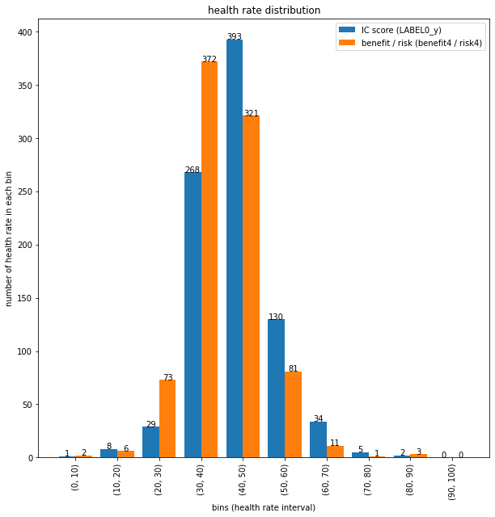
Prediction distribution
Bell curve & normal distribution
IC score health rates gather closer (low variance)
Benefit / risk health rates spread more widely (much higher variance)
Model for IC score makes predictions with lower variance

Slide 43
Conclusion
Lower bound >= 60 is a good choice
The interval for investment strategy should not be too wide
The prediction distribution is near a normal distrobution, which might be a clue for further research

Slide 44
Summary
Collect data
Download CSI300 data
Preprocess data
Clean data (drop nan and column/row with many nan)
Train model
Sent data to data loader
Select benchmark (SH000300)
randomly select 5 stock data
Compute targets and some self-defined features
Train model with loaded data
If pre-trained model exists, train the pre-trained one
Pre-set hyperparameters and choose an optimizer
Inference
Test on validation dataset and other randomly selected stock data
Test the investment strategy suggested by the model predictions with different intervals (upper/lower bound for health rate)
Scale the result

Slide 45
Thank you

